Slide 1
Application: International Trade
CHAPTER 9
Notes:
N. Gregory Mankiw Principles Of Economics Eight Edition

Slide 2
The Determinants of Trade Part 1
The equilibrium without trade
Only domestic buyers and sellers
Equilibrium price and quantity
Determined on the domestic market
Total benefits
Consumer surplus
Producer surplus

Slide 3
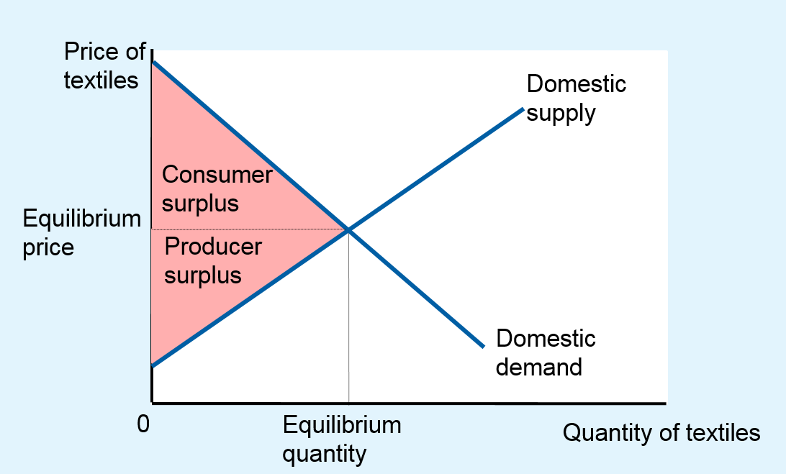
Figure 1 Equilibrium without International Trade
When an economy cannot trade in world markets, the price adjusts to balance domestic supply and demand. This figure shows consumer and producer surplus in an equilibrium without international trade for the textile market in the imaginary country of Isoland.

Slide 4
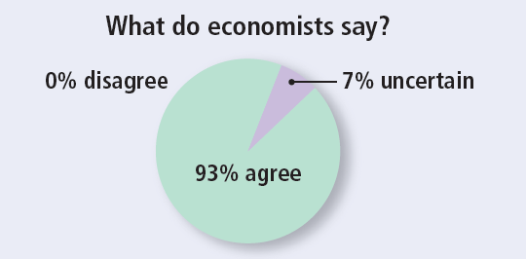
ASK THE EXPERTS Part 1
Trade Deals
“Past major trade deals have benefited most Americans.”

Slide 5
The Determinants of Trade Part 2
Allow for international trade?
Price and quantity sold in the domestic market?
Who will gain from free trade; who will lose, and will the gains exceed the losses?
Should a tariff be part of the new trade policy?

Slide 6
The Determinants of Trade Part 3
World price
Price of a good that prevails in the world market for that good
Domestic price
Opportunity cost of the good on the domestic market

Slide 7
The Determinants of Trade Part 4
Compare domestic price with world price
Determine who has comparative advantage
If domestic price < world price
Export the good
The country has comparative advantage
If domestic price > world price
Import the good
The world has comparative advantage

Slide 8
Winners and Losers from Trade Part 1
Exporting country
Domestic equilibrium price before trade is below the world price
Once trade is allowed
Domestic price rises to equal the world price
Domestic quantity supplied is greater than domestic quantity demanded
The difference: exports

Slide 9
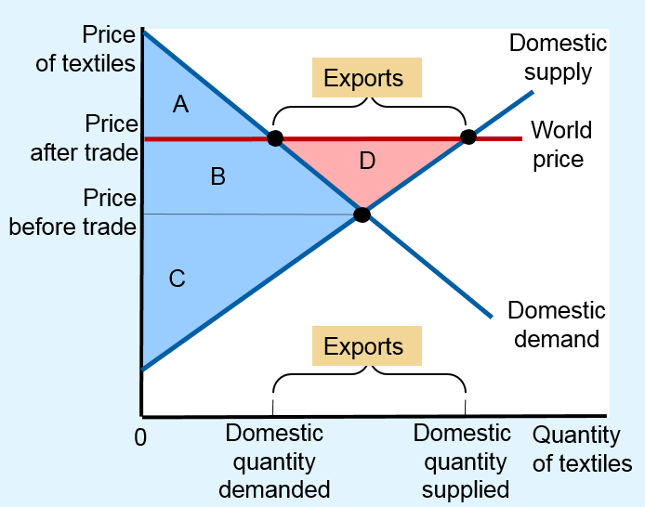
Figure 2 International Trade in an Exporting Country
Once trade is allowed, the domestic price rises to equal the world price. The supply curve shows the quantity of textiles produced domestically, and the demand curve shows the quantity consumed domestically.
Exports from Isoland equal the difference between the domestic quantity supplied and the domestic quantity demanded at the world price.
Sellers are better off (producer surplus rises from C to B + C + D), and buyers are worse off (consumer surplus falls from A + B to A). Total surplus rises by an amount equal to area D, indicating that trade raises the economic well-being of the country as a whole.
Empty Cell | Before Trade | After Trade | Change
Consumer Surplus | A + B | A | -B
Producer Surplus | C | B + C + D | + (B + D)
Total Surplus | A + B + C | A + B + C + D | + D
The area D shows the increase in total surplus and represents the gains from trade

Slide 10
Winners and Losers from Trade Part 2
Exporting country
Before international trade
Consumer surplus
Producer surplus
With international trade
Smaller consumer surplus
Higher producer surplus
Higher total surplus

Slide 11
Winners and Losers from Trade Part 3
Exporting country, with international trade
Domestic producers of the good are better off
Domestic consumers are worse off
Trade raises the economic well-being of a nation
Gains of the winners exceed the losses of the losers

Slide 12
Winners and Losers from Trade Part 4
Importing country
Domestic equilibrium price before trade is above world price
Once trade is allowed
Domestic price drops to equal the world price
Domestic quantity supplied is less than domestic quantity demanded
The difference: imports

Slide 13
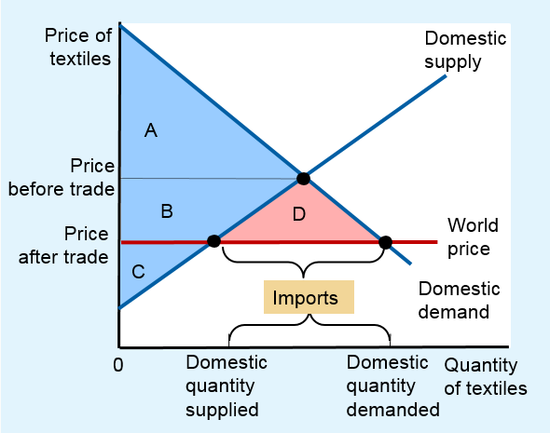
Figure 3 International Trade in an Importing Country
Once trade is allowed, the domestic price falls to equal the world price. The supply curve shows the amount produced domestically, and the demand curve shows the amount consumed domestically.
Imports equal the difference between the domestic quantity demanded and the domestic quantity supplied at the world price.
Buyers are better off (consumer surplus rises from A to A + B + D), and sellers are worse off (producer surplus falls from B + C to C). Total surplus rises by an amount equal to area D, indicating that trade raises the economic well-being of the country as a whole.
Empty Cell | Before Trade | After Trade | Change
Consumer Surplus | A | A + B + D | +(B + D)
Producer Surplus | B + C | C | -B
Total Surplus | A + B + C | A + B + C + D | + D
The area D shows the increase in total surplus and represents the gains from trade

Slide 14
Winners and Losers from Trade Part 5
Importing country
Before international trade
Consumer surplus
Producer surplus
With international trade
Higher consumer surplus
Smaller producer surplus
Higher total surplus

Slide 15
Winners and Losers from Trade Part 6
Importing country, with international trade
Domestic producers of the good are worse off
Domestic consumers are better off
Trade raises the economic well-being of a nation
Gains of the winners exceed the losses of the losers
Trade can make everyone better off

Slide 16
Winners and Losers from Trade Part 7
Tariff
Tax on goods produced abroad and sold domestically
Free trade
Domestic price = World price
Tariff on imports
Raises domestic price above world price
By the amount of the tariff

Slide 17
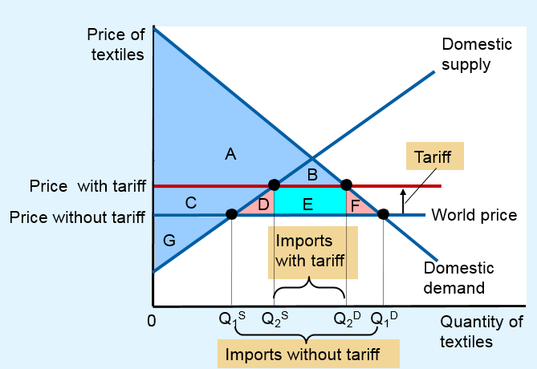
Figure 4 The Effects of a Tariff
A tariff, a tax on imports, reduces the quantity of imports and moves a market closer to the equilibrium that would exist without trade. Total surplus falls by an amount equal to area D + F. These two triangles represent the deadweight loss from the tariff.
Empty Cell | Before Tariff | After Tariff | Change
Consumer Surplus | A+B+C+D+E+F | A + B | - (C + D + E + F)
Producer Surplus | G | C + G | + C
Government Revenue | None | E | + E
Total Surplus | A+B+C+D+E+F+G | A+B+C+E+G | - (D + F)
The area D + F shows the fall in total surplus and represents the deadweight loss of the tariff.

Slide 18
Winners and Losers from Trade Part 8
The effects of a tariff
Price rises by the amount of the tariff
Domestic quantity demanded decreases
Domestic quantity supplied increases
Reduces the quantity of imports
Moves the domestic market closer to its equilibrium without trade
Domestic sellers are better off
Domestic buyers are worse off

Slide 19
Winners and Losers from Trade Part 9
Before the tariff
Consumer surplus
Producer surplus
Government tax revenue = 0
The effects of a tariff
Consumer surplus is smaller
Producer surplus is bigger
Government tax revenue
Total surplus is smaller

Slide 20
Winners and Losers from Trade Part 10
Other benefits of international trade
Increased variety of goods
Lower costs through economies of scale
Increased competition
Enhanced flow of ideas
Transfer of technological advances around the world

Slide 21

Arguments for Restricting Trade Part 1
The domestic producers
Oppose free trade
Believe that the government should protect the domestic industry from foreign competition
“You like protectionism as a ‘working man.’ How about as a consumer?”

Slide 22
Arguments for Restricting Trade Part 2
The jobs argument
“Trade with other countries destroys domestic jobs”
Free trade creates jobs at the same time that it destroys them
The national-security argument
“The industry is vital for national security”
When there are legitimate concerns over national security

Slide 23
Arguments for Restricting Trade Part 3
The infant-industry argument
“New industries need temporary trade restriction to help them get started”
Difficult to implement in practice
The “temporary” policy is hard to remove
Protection is not necessary for an infant industry to grow

Slide 24
Arguments for Restricting Trade Part 4
The unfair-competition argument
“Free trade is desirable only if all countries play by the same rules”
Increase in total surplus for the country
The protection-as-a-bargaining-chip argument
“Trade restrictions can be useful when we bargain with our trading partners”
The threat may not work

Slide 25
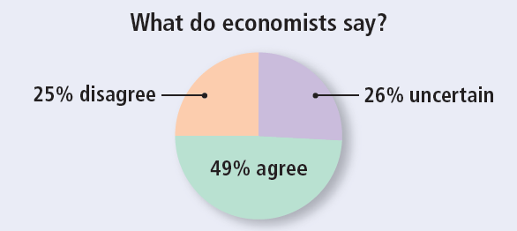
ASK THE EXPERTS Part 2
Trade Deals
“Refusing to liberalize trade unless partner countries adopt new labor or environmental rules is a bad policy, because even if the new standards would reduce distortions on some dimensions, such a policy involves threatening to maintain large distortions in the form of restricted trade.”

Slide 26
Trade agreements and the WTO Part 1
World Trade Organization, WTO
Unilateral approach to achieve free trade
Remove its trade restrictions on its own
Great Britain, 19th century
Chile and South Korea, recent years
Multilateral approach to free trade
Reduce its trade restrictions while other countries do the same
NAFTA, GATT

Slide 27
Trade agreements and the WTO Part 2
North American Free Trade Agreement (NAFTA)
1993, lowered trade barriers among the United States, Mexico, and Canada
General Agreement on Tariffs and Trade (GATT)
Continuing series of negotiations among many of the world’s countries with the goal of promoting free trade

Slide 28
Trade agreements and the WTO Part 3
GATT
United States helped to found GATT
After World War II
In response to the high tariffs imposed during the Great Depression
Successfully reduced the average tariff among member countries from about 40 to 5%
Enforced by the WTO
2015: 162 countries; more than 97 % of world trade

Slide 29
Trade agreements and the WTO Part 4
Advantages of the multilateral approach
Potential to result in freer trade than unilateral approach
Reduce trade restrictions abroad and at home
Political advantage
Producers are fewer and better organized than consumers
Greater political influence

